Slide 1
8th Edition of the cross-border meeting
1 – 3 July 2014
Moscow
Paul Van Geyt

Slide 2
The future of the accountant profession
Introduction
The past: Belgian legislation 1999 for the Institute of Accountants
The actual situation: influence EU rules and IFAC standards: corner stone=
quality and independence!

Slide 3
The future
2. Two important points:
- highest quality possible by competence and independence
= enhance credibility on:
annual accounts = national
consolidation = international

Slide 4
The future
- for who?
investors
all stakeholders (clients)
to create a maximum credibility
= overall importance for the economy in general

Slide 5
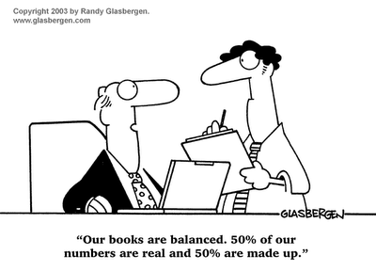
Maximum credibility!

Slide 6
The Belgian evolution -experience
Remember: 3 Belgian Institutes:
-IRE (auditors)
-IEC (accountants)
-IBCF (bookkeepers)
2. Quality control: only legally for IRE
not for accountants and bookkeepers!

Slide 7
What is new?
QC for accountants!!
- decision council IEC: introduction of a new professional standard on QC (no law)
- first start in 2014 with try out on free basis
- official start in 2015

Slide 8
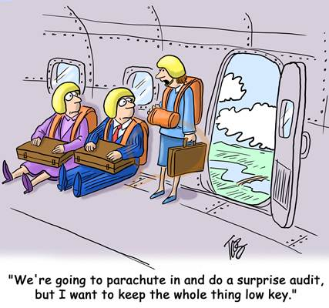
How not in practice?

Slide 9
How in practice?
A new professional standard QC 7 May 2012:
- establishing a control committee
- QC becomes mandated
- spirit of collegiality and help

Slide 10
First phase 2014
= pilot phase with goal:
- principle: more help than sanctions
- control on: respect standards, internal organization and procedures, adapted fully necessity of professional work and on the size of the firm
- exchange of experience
- permanent education: standards + deontology

Slide 11
The official start 2015
Goal: control all individual members + firms
Principle: ultimate decision results QC by the Council IEC Institute
But: practical organization Control Commission

Slide 12
Basic rules QC in 2015
Systematic control every member 7 years
Incident controls: facts or complaints
Thematic controls : some aspects
If negative-deficiencies: improvement plan + control afterwards

Slide 13
Role QC Control Commission
elaboration procedures, instructions and tools (manual)
Establish annual control program
Final judgment on QC results
Propose list of controllers

Slide 14
Role QC Control Commission
Education controllers and follow up
Annual report on results QC
Ultimate decision by Council Institute

Slide 15
Actual overview situation of the accountants QC
May 2012: installation Control Commission
2013: publication website: ‘white book quality’
2014: Publication manual ‘organization of the firm and procedures’, questionnaire for controllers, selection and education of controllers, preparation control work

Slide 16
Actual situation of the accountants QC 2014
For controllers: organization direct contact with Control Commission and tools on website
Start of practice QC: on free basis!
but: all members of Council IEC and the Control Commission will have the QC on their firm or person!

Slide 17
Future: 2015
Base: evaluation results pilot phase 2014
Start of regular QC on following rules:
. Every 7 year for everyone
. 4.200 members= 300 QC a year
. Question list send to each controlled member

Slide 18
Future: 2015
List controllers send in advance: refuse?
After QC discussion with controlled accountant
Result in report to QC Commission
Decision QC Control Commission
BUT: emphasis on help, coaching, follow up + advices on improvements

Slide 19
General Conclusion
Central point in this story:
Societal role of accountants!
- person of confidence enterprises
- independent function
- build on competence + correct service
- more important in great complexity of regulation and international standards

Slide 20
Conclusion QC
= enormous challenge for the profession to bring high quality of their work in an environment of great complexity of rules and legislation,
= gives professionals the necessary credibility and a clear message to all stakeholders, especially to their clients.

Slide 21
A clear message
QC is not a pleasant thing but necessary,
even on a free base for accountants.
Future legislation? Probably!
So be prepared!

Slide 22
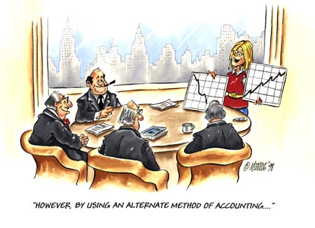
Final Conclusion

Slide 23
Final Conclusion
The future of the profession=
Quality for ever and always!!
Thank you for your attention.

