Slide 1
IFAC's Global Knowledge Gateway-a shared, global resource for accountants
Daria Kukhar
International Federation of Accountants
THE 8TH CROSS-BORDER MEETING
July 2, 2014
Moscow

Slide 2
Accountants in Society

Slide 3
IFAC Operating Lines
Supporting standards development
Improving quality and capacity
Global representation and advocacy
Supporting the profession

Slide 4
Supporting Standards Development
Foster high-quality financial information
Promote confidence in markets
Enhance public resource management
Facilitate regional and international economic integration

Slide 5
Supporting Standards Development
Progress to Date:
80+ government/public sector entities using/planning to adopt IPSASs
100+ jurisdictions using/adopting clarified ISAs or using as a basis for national standards
120+ jurisdictions using/adopting the Code of Ethics for Professional Accountants

Slide 6
Improving Quality and Capacity
Supporting high-quality PAOs and strengthening the profession
Member Body Compliance Program
Professional Accountancy Organization (PAO) Development
MOSAIC

Slide 7
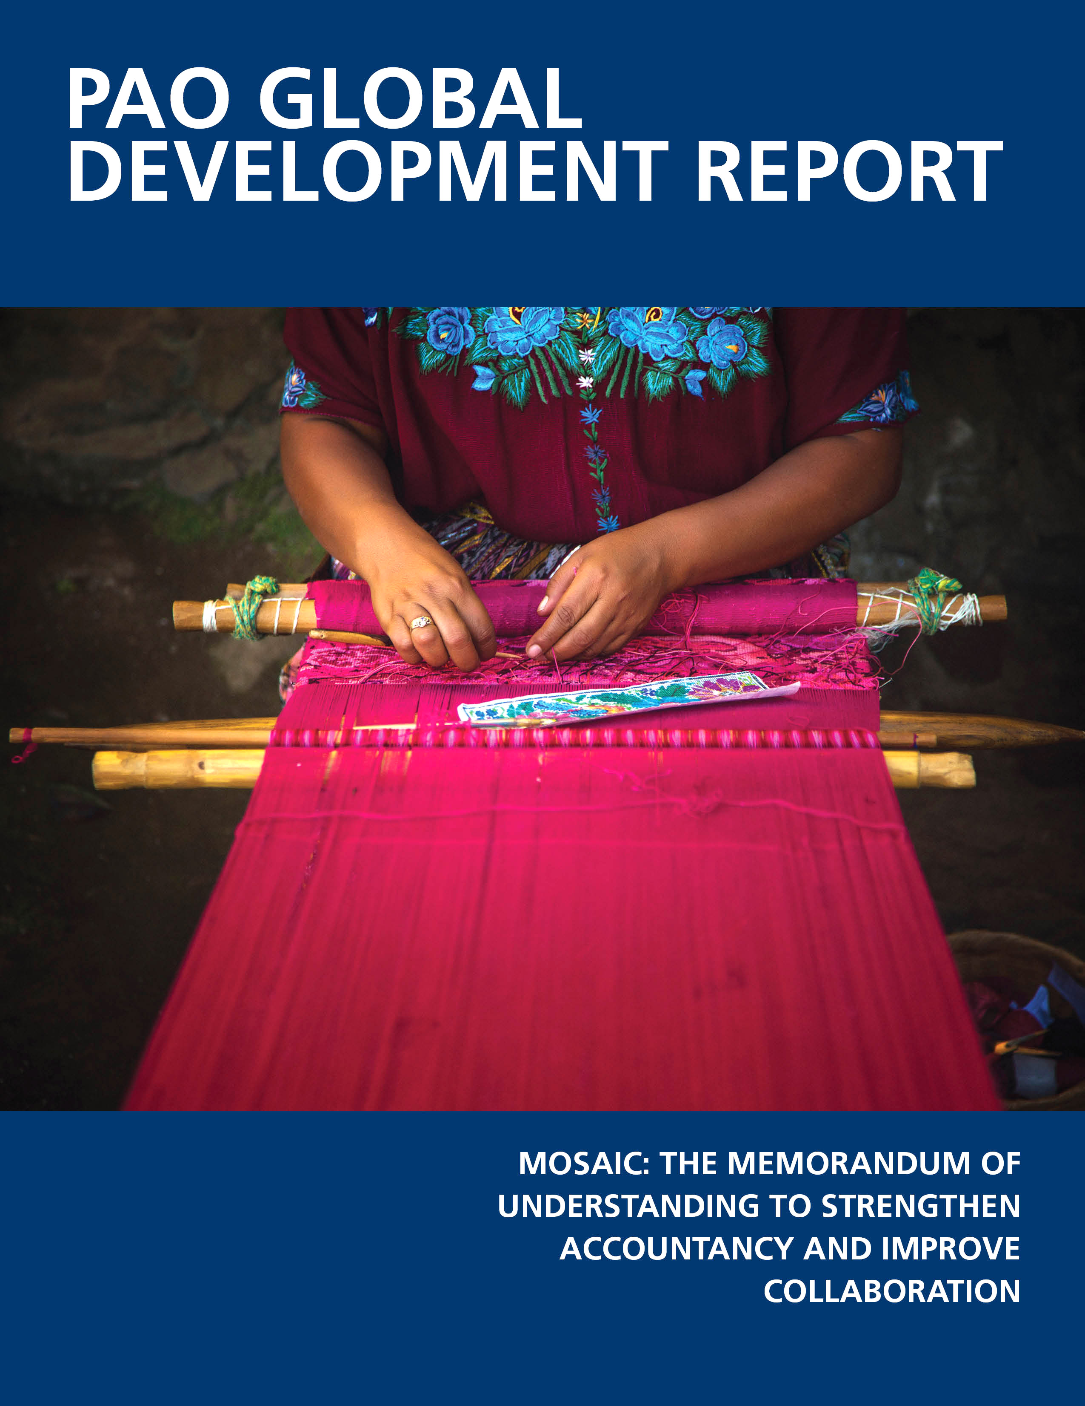
Improving Quality and Capacity
Progress to Date:
Supporting and managing MOSAIC
Publishing 110 actions plans in 2013
Reviewing eight World Bank ROSC Reports
DFID/IFAC agreement

Slide 8
Global Representation and Advocacy
Leveraging IFAC’s position as an independent public interest voice for the profession
Promote profession’s interests
Stimulate discussion
Convene interested stakeholders

Slide 9
Global Representation and Advocacy
Progress to Date:
ASEAN Seminar on FRSC
Convening global public sector leaders on public sector financial management
Engaging the G-20, European Commission, IFRS, and others on key matters

Slide 10
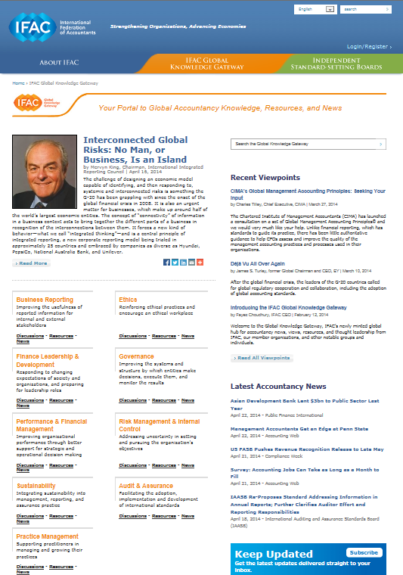
Supporting the Profession
Progress to Date:
Launching Global Knowledge Gateway
Publishing International Good Practice Guidance
Creating resources for SMPs

Slide 11
International Good Practice Guidance
Principles for Effective Business Reporting Processes-11 key principles for evaluating and improving business reporting processes
Developing and Reporting Supplementary Financial Measures—Definition, Principles, and Disclosures (ED, comments were due May 26)

Slide 12
Support for Professional Accountants Global Knowledge Gateway
Business reporting
Ethics
Financial leadership & development
Governance
Performance and financial management
Risk management & internal control
Sustainability
Audit & assurance
Practice management

Slide 13
Global Knowledge Gateway- Six Key Components
Viewpoints
Accountancy News
Resources
Discussions
Topical News
Upcoming Events
Register!

Slide 14
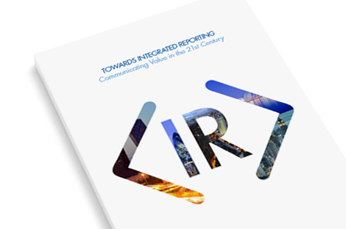
Enhanced Organizational Reporting
Non-financial reporting is important for:
Decision-making
Promoting transparency
Discharging accountability
Areas of Focus:
Is Integrated Reporting living up to its promise?
What lesson can be learned from narrative reporting?

Slide 15
Latest Knowledge Gateway-June 24, 2014
Viewpoint | Shared Standard Setting in the Public Interest: A Strong Model by Fayez Choudhury, CEO, IFAC
Discussion | Supporting the Implementation of International Standards—What’s Next?
News | View All CAQ’s Field-Testing Yields Further Recommendations to Auditor’s Reporting Model

Slide 16
Notes:
As we look ahead, we must keep working to keep our profession on the right and relevant track.

